Slide 1


SP3176 The Universe Chapter 1: Discovering our Universe
Lim Zhi Han
Notes:
1 min

Slide 2
Learning Objectives
At the end of this lesson, you should be familiar with the terminologies, history and early models of our Universe. You will also begin to understand astronomy as a scientific discipline based on observational evidence.
You will understand the basics of telescopes and use one to look at celestial objects.
Notes:
1 min

Slide 3
Terminologies (pre-lesson homework)
Fixed stars | Stars that appear to remain in fixed relative positions in the night sky when observed over long periods of time.
Planet | A celestial body that orbits a star, is spherical in shape due to its own gravity, and has cleared its orbit of other debris.
Galaxy | A vast collection of stars, gas, dust, and other celestial objects bound together by gravity. Our is an example of a galaxy.
Milky Way | The galaxy in which our solar system resides. It is a spiral galaxy.
Cluster | In astronomy, a cluster refers to a group of stars, galaxies, or other celestial objects that are gravitationally bound together.
Constellation | A specific region of the sky that contains recognizable patterns of stars. Helps to segment the sky into different areas
Gravity | A fundamental force of nature that attracts objects with mass toward each other.
Celestial sphere | An imaginary 2D surface of a sphere surrounding Earth, onto which the positions of stars and other celestial objects are projected.
Notes:
1 min

Slide 4
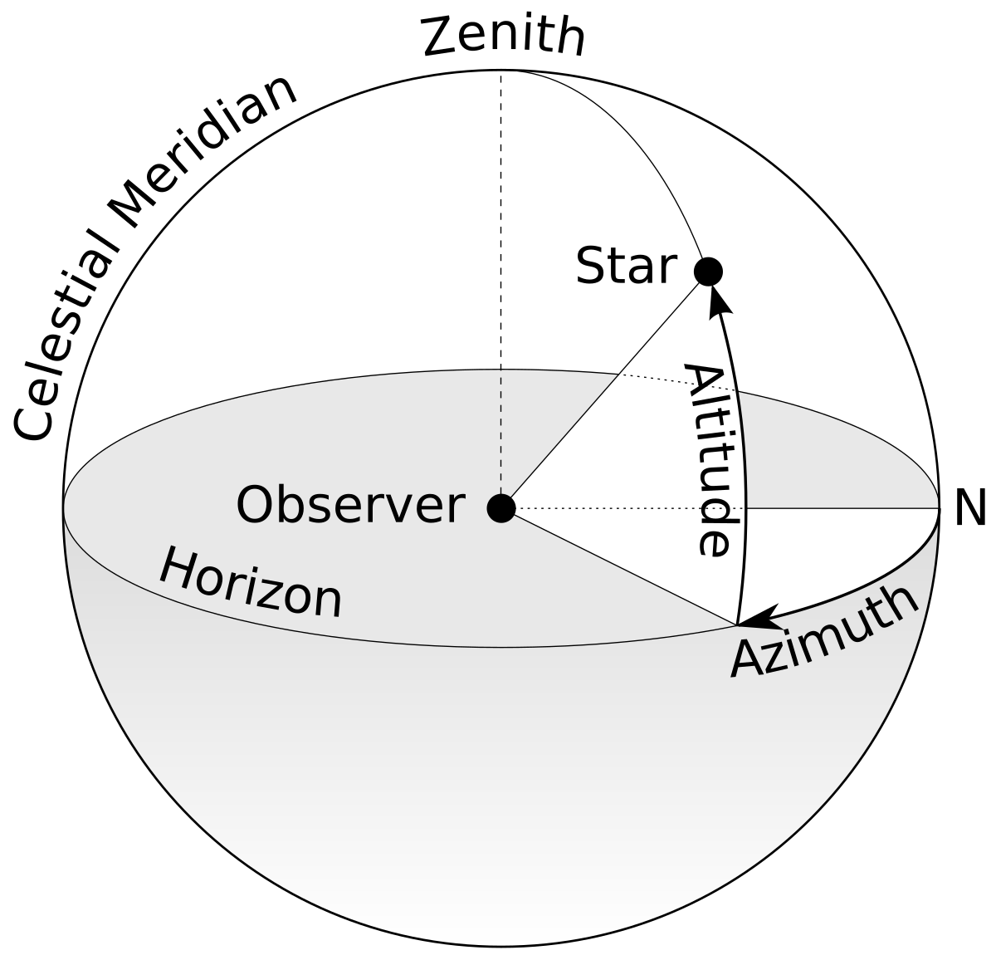
Terminologies (pre-lesson homework)
Local sky | The visible portion of the sky from a particular observer's point of view.
Zenith
Azimuth
Altitude
Ecliptic | The apparent path of the Sun in the sky as seen from Earth over the course of a year. It is also the plane in which Earth orbits the Sun.
Arc-minute, arc-second | Units of angular measurement. One degree is divided into 60 arc-minutes (symbol: ') and each arc-minute is further divided into 60 arc-seconds (symbol: ").
Notes:
1 min

Slide 5
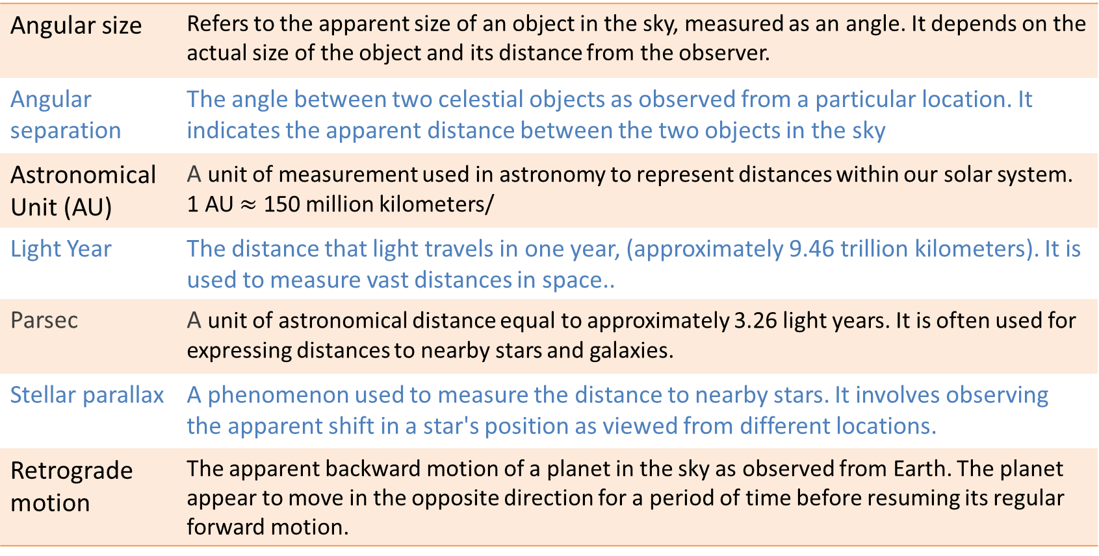
Terminologies (pre-lesson homework)
Angular size | Refers to the apparent size of an object in the sky, measured as an angle. It depends on the actual size of the object and its distance from the observer.
Angular separation | The angle between two celestial objects as observed from a particular location. It indicates the apparent distance between the two objects in the sky
Astronomical Unit (AU) | A unit of measurement used in astronomy to represent distances within our solar system. 1 AU $≈$ 150 million kilometers/
Light Year | The distance that light travels in one year, (approximately 9.46 trillion kilometers). It is used to measure vast distances in space..
Parsec | A unit of astronomical distance equal to approximately 3.26 light years. It is often used for expressing distances to nearby stars and galaxies.
Stellar parallax | A phenomenon used to measure the distance to nearby stars. It involves observing the apparent shift in a star's position as viewed from different locations.
Retrograde motion | The apparent backward motion of a planet in the sky as observed from Earth. The planet appear to move in the opposite direction for a period of time before resuming its regular forward motion.
Notes:
1 min

Slide 6
Stellar Parallax
Notes:
Ask everyone to stand up, half shift to the left of the room half go right. Hold up a ball. Where is the ball located wrt the the background stars?
5 min

Slide 7

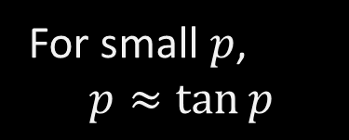
Fixed (background) star
Nearby star of interest
$$\tan{p}=\frac{1 AU}{D}$$
p
Earth
D
Sun
For small $p$,
$$p≈\tan{p}$$
1 AU
Notes:
2 min

Slide 8
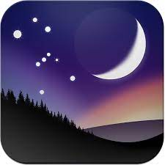
Stellarium (pre-lesson homework)
Played with it already?
Notes:
1 min

Slide 9
Challenge:
Use Stellarium to show the retrograde motion of planets
Notes:
1 min

Slide 10
Challenge:
Use Stellarium to show the retrograde motion of planets
Open Stellarium
Remove ground [G]
Remove atmosphere [A]
Remove cardinal points [Q]
Switch to equatorial mount [Ctrl + M]
Toggle meteor showers [Ctrl + SHift + M]
Show ecliptic (Sky and viewing option - Markings)
Click fast forward 5 times. Observe motion of moon and other solar system objects.
Click fast forward one/two more times. Click on Mars or Jupiter. Shift T to show trail.
Notes:
1 min

Slide 11
Part 1:
From ancient folks to the fathers of modern astronomy

Slide 12
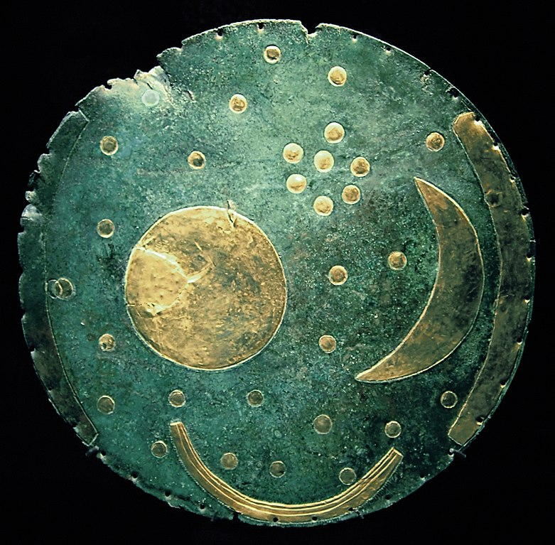
Ancient star map: Nebra sky disk
More than 3000 years old!
Found in Saxony-Anhalt, Germany.
Star cluster represents Pleaides?
Calendar device similar to Stonehenge?
Image credit: Dbachman, CC-BY-SA-3.0
Notes:
1min
I’m not a historian so I’ll would go into details of this. However something quite worthwhile for you to discover is how Stonehenge or similar ancient constructs were used as calendar devices. You can self read on a bus or train…

Slide 13
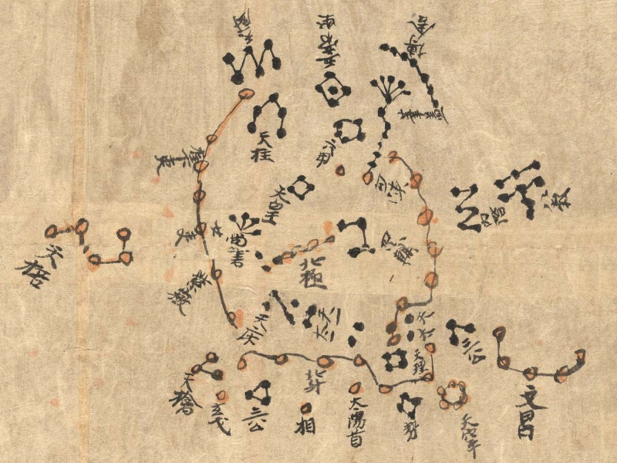
Ancient star map: Dunhuang Star Atlas
Years 649—684
The oldest complete star atlas with more than 1300 stars
Accurate to within 1º
Note the Big Dipper.
Image credit: J. M Bonnet Bidaud, F. Praderie, S. Whitfield
Notes:
1min
This set of chinese star maps is really quite amazing. Can you find the big dipper in this drawing?

Slide 14
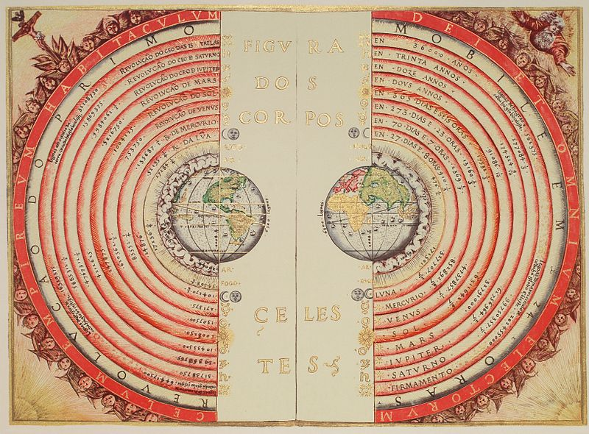
Geocentric, Static Earth and Perfect Circles
Early model to explain periodic celestial movements.
Advocated by influential Greek philosophers Plato and Aristotle.
Other schools of thought exist but not as popular.
Image credit: Bartolomeu Velho, Public domain
Notes:
1 min
At around 300BC, Plato, Aristotle and their students formed a major school of thought. They were one of the first people who try to use models to make sense of our world. Although now we know that their models are not sufficiently scientific, they have nevertheless helped to shape how modern scientists think.

Slide 15
Geocentric, Static Earth and Perfect Circles
Mix of logic and mystic.
Lack of stellar parallax observations => Earth is not moving.
Heavenly bodies move in circles/ spheres which are perfect geometrical shapes
Image credit: Bartolomeu Velho, Public domainOooooooooooo
Notes:
2 min
In their model of the universe, the unmoving earth is at the centre, with the sun, moon, planets and stars orbit around earth. Why unmoving Earth? Partly due to the mystic belief that Earth is at the center of the universe. And also partly due to the lack of evidence that suggest otherwise. It should be noted that astronomical observations were not accurate enough to detect stellar parallax.

Slide 16
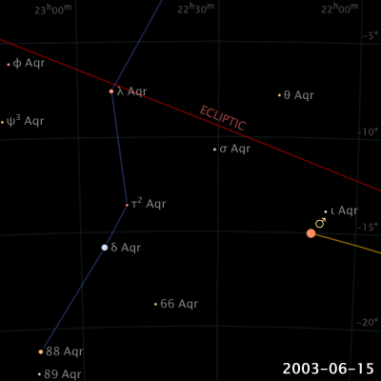
Retrograde Motion of Planets
Planets drift from East to West through the year.
But moves in opposite direction sometimes!
Does Aristotle’s Geocentric universe account for this observation?
Image credit: Eugene Alvin Villar, CC BY-SA 4.0
Notes:
3 min
But there is something peculiar about planets.
Stars pretty much stay in their relative positions everyday. The constellation scorpio does not change shape to become a rooster. But the position of planets do change! They “wander” from constellations to constellation. How planets drift is usually from east to west, but in some months they go the opposite way. This have been observed for by ancient astronomers but the Aristotle model cannot quite account for this.
Or show it live on stellarium (not web)

Slide 17
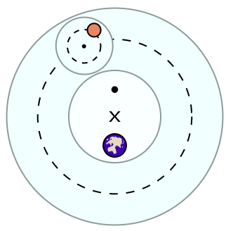
Ptolemy’s Solution: Circles within circles
Greek mathematician, astronomer, and geographer (AD 100–170)
Planet rotates in epicycle (small circle).
Epicycle rotates in deferent (big circle).
Image credit: Fastfission, Public domain
Notes:
1 min
It took a math geek to come up with a solution. Ptolemy introduced the concept of “Circles within a circle”.

Slide 18
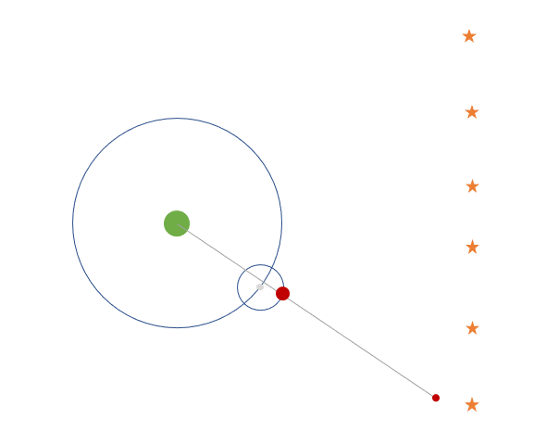
Ptolemy’s Solution: Circles within circles
Fits observational data for retrograde motion!
Notes:
With epicycles or circles in circles, he can create the exact paths of planets including the retrograde motion.
In fact his method can be pushed to the extreme. See this video
https://www.youtube.com/watch?v=r6sGWTCMz2k
Any closed path can be recreated using a number epicycles.
The beautiful result is now known as a fourier series, which if you are interested, you can read Ervin’s very gentle and humourous introduction to fourier series and/or watch this video
https://www.youtube.com/watch?v=qS4H6PEcCCA

Slide 19
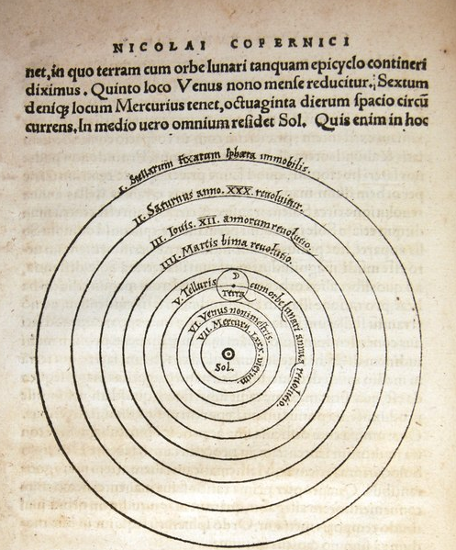
Heliocentric model of Nicolaus Copernicus (1473 – 1543)
The Sun is at the centre of our Universe!
Image credit: Copernicus, CC-BY-SA-4.0
Notes:
1 min
Aristotle’s school was so influential that non-geocentric models were ignored.
About a thousand years later, Copernicus fought hard to push for the heliocentric model, which places the Sun at the center of the Universe.

Slide 20
Heliocentric model of Nicolaus Copernicus (1473 – 1543)
Earth is orbiting the Sun, just like other planets.
Image credit: Copernicus, CC-BY-SA-4.0
Notes:
With the Earth and other planets orbiting.
Corpernicus claims that in this model, retrograde motion can be reproduced without using epicycles.

Slide 21
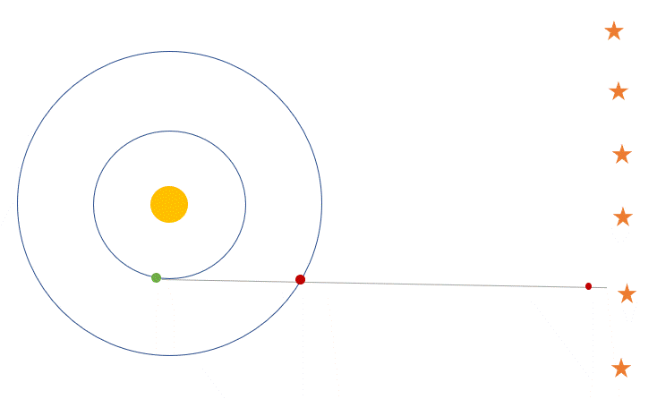
Heliocentric model of Nicolaus Copernicus (1473 – 1543)
Not for the ultra-egoistic.
Accounts for retrograde motion, qualitatively.
Notes:
1 min
Lets see how..

Slide 22
Heliocentric model of Nicolaus Copernicus (1473 – 1543)
Circular orbits.
Do not match observation data numerically.
Not widely accepted.
Notes:
1 min
The problem with Copernicus’ model was that while it can produce the qualitative behaviours of retrograde motion, the exact positions, the numerical coordinates in the sky of the planets cannot be precisely matched. So his model is actually not scientifically justifiable.

Slide 23
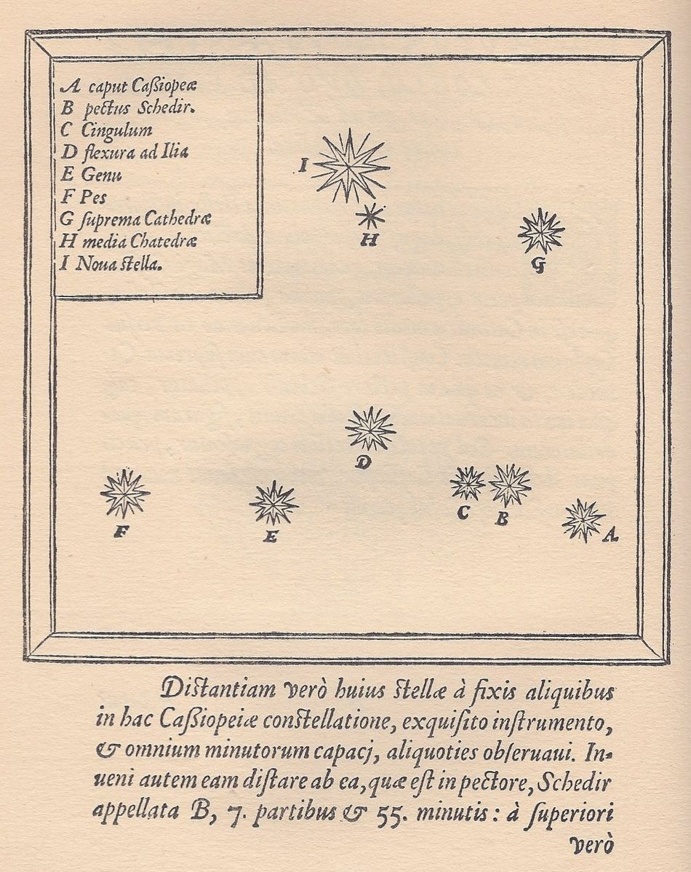
Tycho Brahe’s Observations
Danish astronomer (1546–1601)
Made systematic, rigorous observations with the best instruments available.
Famous for sighting and record of the supernova of 1572
Image credit: Tycho Brahe, Public domain
Notes:
1 min
While theories are developing, people are making better and better astronomical observations.
And the supreme astronomer at that time was Tycho Brahe. He had an illustrious career, and was given an island to you know, see stars.

Slide 24
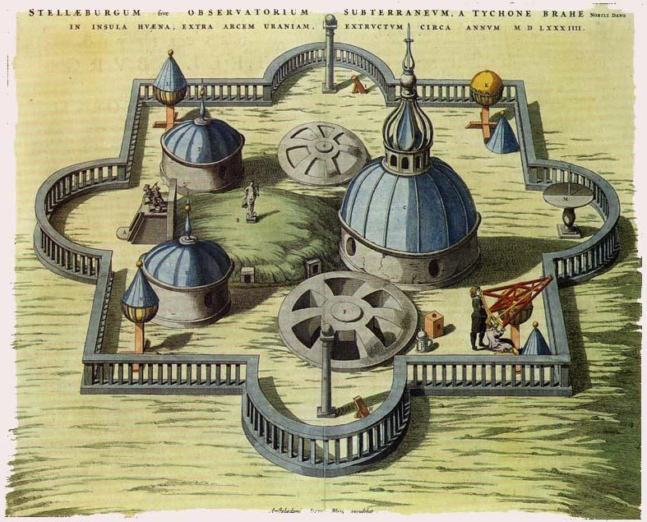
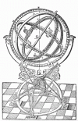
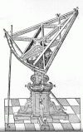
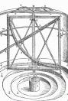
Tycho Brahe’s Observations
Offered lordship and island.
Built observatory and alchemy research centre.
Custom-built his own instruments.
Image credit: Willem Basue, Public domain
Notes:
1 min
Which he did very very well using his own custom built instruments. These instruments were all for the purpose of pinpointing celestial objects on the sky map. These are naked eye equipments, no optics involved, and he could reach up to 40 arc second precision, which is 0.01 degrees.

Slide 25
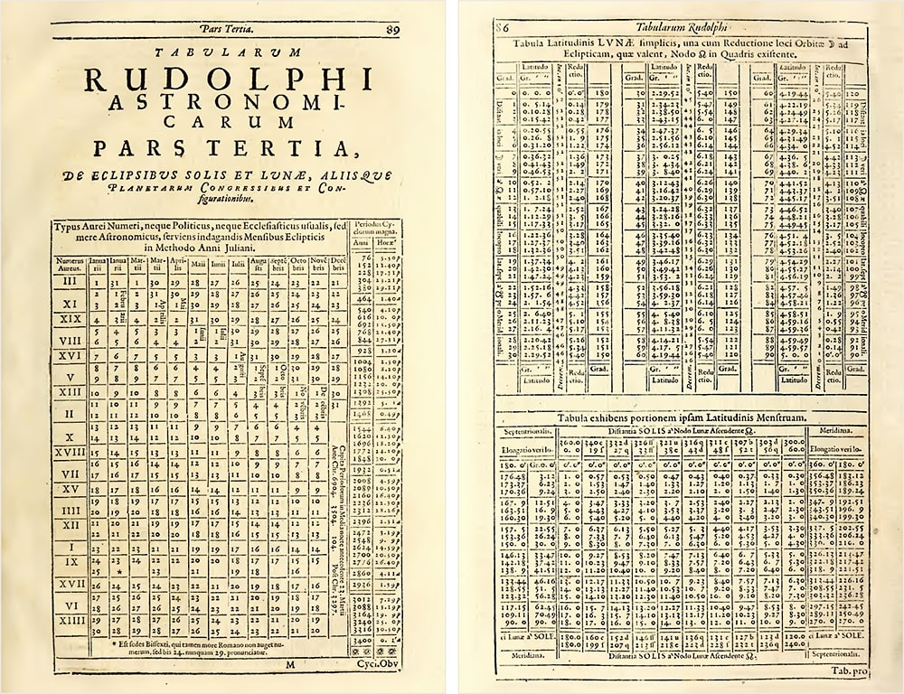
Tycho Brahe’s Observations
Rudolphine Tables, a star and planetary catalogue based on Tycho’s observation data.
Published in 1627 after Tycho’s death by Johannes Kepler.
Image credit: Johannes Kepler, Public domain
Notes:
1 min
His results are essentially numerical data. Lots of it, since he has many people working for him.
So what comes after collecting all the numerical data?

Slide 26
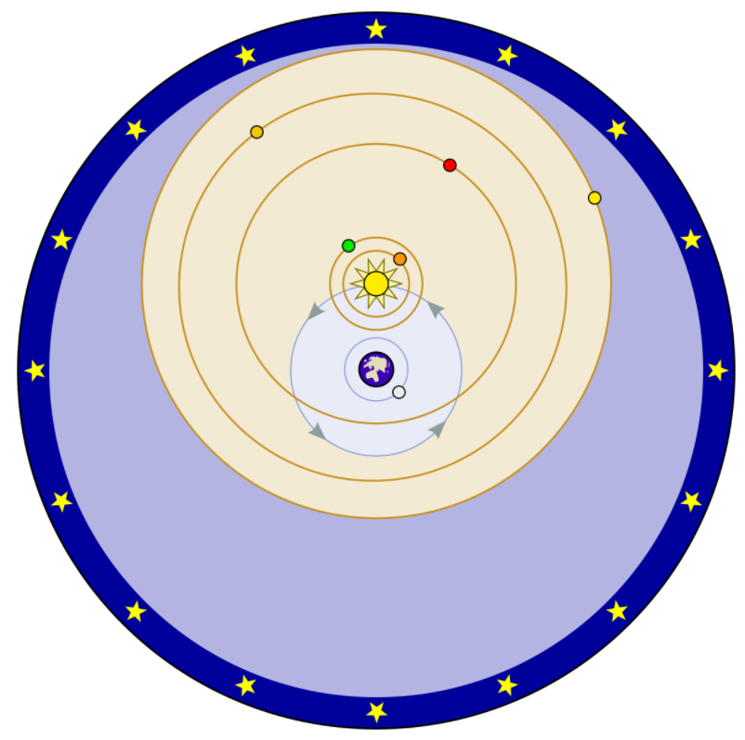
Tycho Brahe’s geo-heliocentric model
The Sun and fixed stars orbit round the Earth.
Planets orbit round the Sun.
Best of both worlds?
Image credit: Fastfission, Public domain
Notes:
1min
Tycho brahe thought, maybe, I should make my own model, and use my data to support my model.
Brahe’s model is pretty interesting. It is a combination of geo and heliocentric model.

Slide 27
In-class Activity 1: Observing the Crux
Launch Stellarium.
Set the time and date to 11 Jan 2022, 1:30 am.
Search for Crux.
Increase the time by the hour until 6:30 am.
What do you observe?
Notes:
3 min break
5 min activity

Slide 28
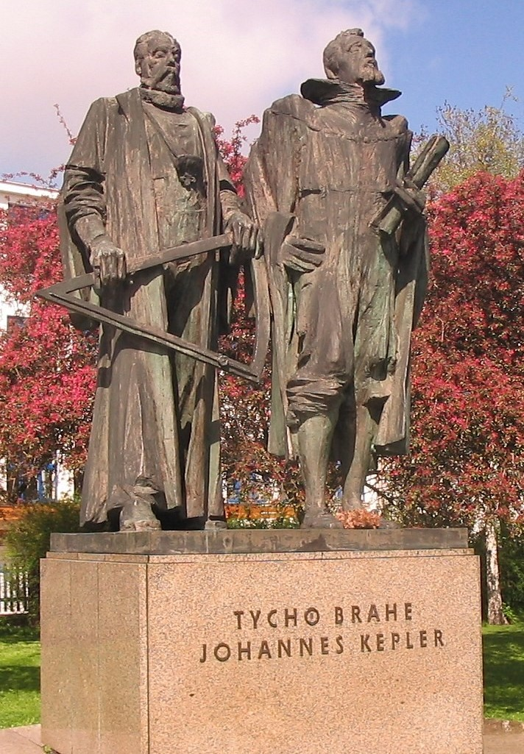
Johannes Kepler (1571—1630)
German astronomer and mathematician.
Worked under Tycho Brahe in 1600.
Inherited Brahe’s data (and position)
Adopted heliocentric model and derived 3 laws of planetary motion.
Image credit: Josef Vajce, Public domain
Notes:
1min
So Brahe came up with a model and wants to verify it. But you know that isn’t what he is good at. So employed Johannes Kepler, who was a young and brilliant mathematician. And he says, hey dude, here’s all my data, prove that I’m right. But 1 year later, in 1601, Tycho Brahe died.. And Kepler took over brahe’s position as the boss of the institute. It was kind of sus…

Slide 29
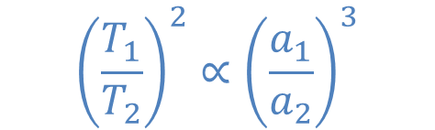
Kepler’s Laws of Planetary Motion
Law of ellipses
Law of equal areas
Harmonic Law
$${\left(\frac{T_{1}}{T_{2}}\right)}^{2}∝{\left(\frac{a_{1}}{a_{2}}\right)}^{3}$$
Notes:
2 min
But whatever, Kepler made very very good use of Tycho’s data. He essentially curve-fitted the data and formulated the laws of planetary motion.
The first law tells us the path of the planet.
The second tells us the speed at which the planet move in the path.
The third law tells us the relationship between the paths of different planets.

Slide 30
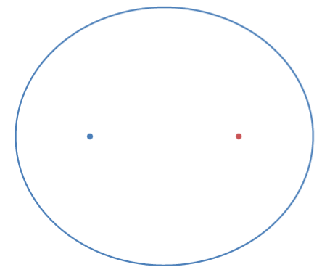
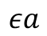
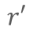
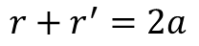
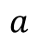
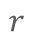
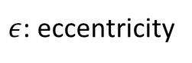
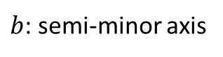
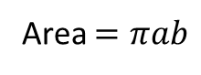
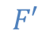
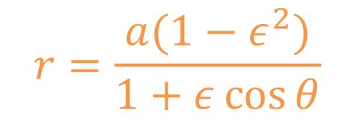
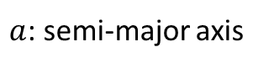

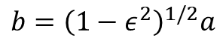
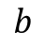
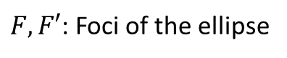
Kepler’s Laws of Planetary Motion
$$r=\frac{a(1−ε^{2})}{1+ε\cos{θ}}$$
Law of ellipses
Plot on Desmos:
a=2
E=0.1
r=a(1-E^2)/(1+Ecos theta)
Set -2<E<2, step 0.01
Play with the slider!
$F, F′$: Foci of the ellipse
$$b$$
$a$: semi-major axis
$b$: semi-minor axis
$$F′$$
$$εa$$
$$F$$
$ε$: eccentricity
$$a$$
$$r+r^{′}=2a$$
$$r′$$
$$r$$
$$b={\left(1−ε^{2}\right)}^{1/2}a$$
Area $=πab$
Notes:
2 min
Instead of a circular orbit as suggested by Corpernicus, Kepler’s model is an elliptical orbit. Let’s draw an elliptical orbit, using an online math tool called Desmos. Everyone do to desmos/com
Plot in Desmos
a=2
E=0.1
r=a(1-E^2)/(1+Ecos theta)
Change E from -1.5 to 1.5 in steps of 0.01

Slide 31
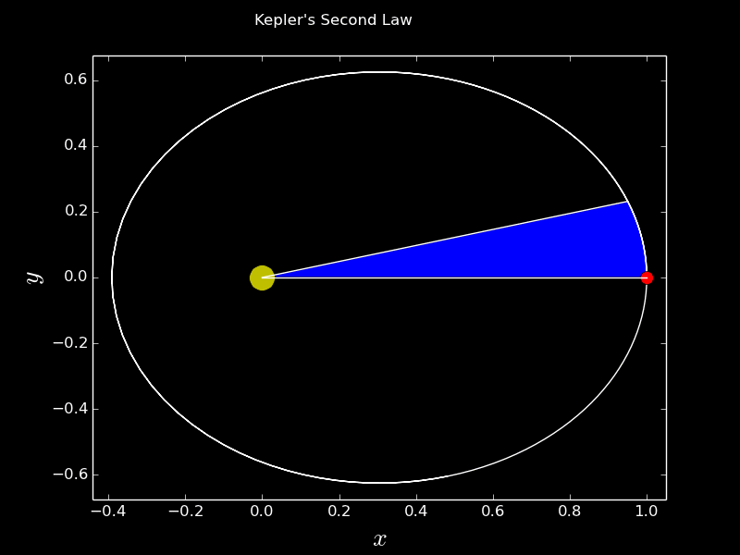
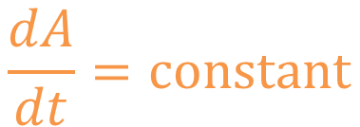
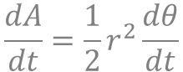
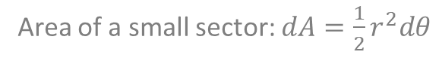
Kepler’s Laws of Planetary Motion
Law of ellipses
Law of equal areas
$$\frac{dA}{dt}=constant$$
Area of a small sector: $dA=\frac{1}{2}r^{2}dθ$
$$\frac{dA}{dt}=\frac{1}{2}r^{2}\frac{dθ}{dt}$$
Image credit: Saptaparna Bhattacharya, CERN
Notes:
1 min
The second law tells us how fast the planet will move. If it is closer to the sun, it’ll move faster.

Slide 32


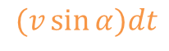
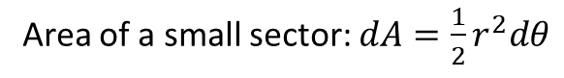
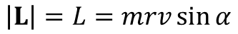
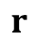

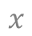
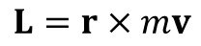
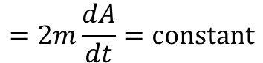
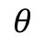
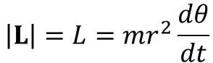
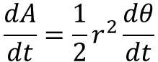


Kepler’s Laws of Planetary Motion
For those who are interested…
Law of ellipses
Law of equal areas
Kepler’s second law is in fact conservation of angular momentum L.
$$L=r×mv$$
$$v$$
$$\left|L\right|=L=mrv\sin{α}$$
$$α$$
$$(v\sin{α})dt$$
$$\left(v\sin{α}\right)dt=rdθ$$
$$\frac{dA}{dt}=constant$$
$$v\sin{α}=r\frac{dθ}{dt}$$
$$r$$
$$dθ$$
$$θ$$
$$x$$
$$\left|L\right|=L=mr^{2}\frac{dθ}{dt}$$
Area of a small sector: $dA=\frac{1}{2}r^{2}dθ$
$$=2m\frac{dA}{dt}=constant$$
$$\frac{dA}{dt}=\frac{1}{2}r^{2}\frac{dθ}{dt}$$
Notes:
2 min
For those who know what angular momentum is, K’s second law if in fact the conservation of angular momentum.

Slide 33

Kepler’s Laws of Planetary Motion
Law of ellipses
Law of equal areas
$$\frac{dA}{dt}=constant$$
Area of a small sector: $dA=\frac{1}{2}r^{2}dθ$
$$\frac{dA}{dt}=\frac{1}{2}r^{2}\frac{dθ}{dt}$$
Notes:
2 min
For those who know what angular momentum is, K’s second law if in fact the conservation of angular momentum. If you do not know what angular momentum is, it’s ok, start by watching this video: https://www.youtube.com/watch?v=VmeM0BNnGR0

Slide 34
Kepler’s Laws of Planetary Motion
Law of ellipses: The orbit of each planet is an ellipse, with the Sun located at one of its foci.
Law of equal areas: A line drawn between the Sun and the planet sweeps out equal areas in equal times as the planet orbits the Sun.
Harmonic Law: The square of the time taken for a planet to complete one revolution about the Sun (relative to the stars) is directly proportional to the cube of the semimajor axis of the planet’s orbit.
Notes:
2 min
The first two laws were formulated with only data of Mars. Converting those numbers into these brilliant quantifiable statements. It is really really amazing how Kepler did it, without a computer…
The third law was actually derived much later than the first 2 laws, because he had to analyse more data of other planets.

Slide 35


Kepler’s Laws of Planetary Motion
Table: NASA’s normalised planetary data
Law of ellipses
Law of equal areas
Harmonic Law
$${\left(\frac{T_{1}}{T_{2}}\right)}^{2}∝{\left(\frac{a_{1}}{a_{2}}\right)}^{3}$$
Use this, derive the third law?
Notes:
1 min
Suppose you have some consolidated data that looks this, what will you do?

Slide 36

Galileo Galilei (1564—1642)
Adopted Copernicus’ model.
Used his (self-made) telescope to look into the heavens.
Observed craters on Moon, Jupiter’s moons, phases of Venus, …
Showed that all object fall similarly under gravity.
Image credit: Wellcome Library, London CC-BY-SA-4.0
Notes:
1 min.
Galileo was Kepler’s contemporary. The two shared some similar beliefs and exchanged a few letters in support of each other while the rest of their worlds (particularly Galileo’s) try to shut them in.

Slide 37

Galileo’s sketch and observation of the moon
“On the fourth or fifth day after conjunction, when the Moon displays herself to us with brilliant horns, the boundary between the bright and dark parts does not form a uniformly oval line, as would happen in a perfectly spherical solid, but is marked by an uneven, rough, and very sinuous line.”
Excerpt and image from Sidereus Nuncius by Galileo Galilei
“Sinuous” in Singlish: Turn here turn there.

Slide 38
Galileo’s sketch and observation of the moon
“A great number of dark spots, entirely separated from the dark part, are distributed everywhere over almost the entire region already bathed by the light of the Sun. … these small spots have a dark part on the side towards the Sun while on the side opposite the Sun they are crowned with brighter borders like shining ridges. An we have an almost entirely similar sight on Earth, around sunrise, when the valleys are not yet bathed in light but the surrounding mountains facing the Sun are already seen shining with light. ”
Excerpt and image from Sidereus Nuncius by Galileo Galilei
“Sinuous” in Singlish: Turn here turn there.

Slide 39

Galileo agrees with Da Vinci on “Earthshine”
“In an equal and grateful exchange the Earth pays back the Moon with light... {Describes moon cycle at length} In this sequence, then, in alternative succession, the lunar light bestows upon us her monthly illuminations, now brighter, now weaker. But the favour is repaid by the Earth in like manner, for when the Moon is found near the Sun around conjunction, she faces the entire surface of the hemisphere of the Earth… and receives reflected light from Earth. Because of this reflection, the inferior hemisphere of the Moon, although destitute of solar light, appears of considerable brightness. ”
Image: WikiCommons
Excerpt from Sidereus Nuncius by Galileo Galilei

Slide 40
Galileo Galilei looks at Jupiter O
*
O
7 Jan 1610
*
*
O
8 Jan 1610
*
*
*
10 Jan 1610
*
O
*
11 Jan 1610
*
O
*
12 Jan 1610
O
*
*
*
13 Jan 1610
*
O
*
*
*

Slide 41
Galileo Galilei looks at Jupiter O
O
*
15 Jan 1610
*
*
*
O
16 Jan 1610
*
*
*
17 Jan 1610
O
*
*
18 Jan 1610
O
*
*
19 Jan 1610
O
*
*
*
20 Jan 1610
O
*
*
*

Slide 42

Isaac Newton (1643—1727)
Laws of Mechanics
Calculus
Law of Gravitation
Derives Kepler’s laws theoretically
“If I have seen further it is by standing on the shoulders of giants.”
Image credit: Alexander Borek, CC-BY-SA-4.0
Notes:
1 min
Isaac Newton, born slightly after Kepler and Galileo died, is the guy we all know that “invented” calculus and “discovered” gravity. His theories were immediately recognized because he used them to derived Kepler’s laws. Perhaps you have heard of this quote: “If I have seen further it is by standing on the shoulders of giants.” Although never explicitly stated, the “giants” probably included Kepler and Galileo.

Slide 43

Activity: Hands-on with the SPS telescope
Notes:
3 groups 20 mins for each

Slide 44
Part 2:
Introduction to telescopes

Slide 45
Purpose of a Telescope
Gather light. So we can see faint objects.
Resolving power. So we can see closely spaced objects.
“Zoom”, “Magnify”.

Slide 46


Refractor Telescope
Objective
Eyepiece
$$f_{1}$$
$$f_{2}$$
Fun fact:
Galileo used a concave lens for the eyepiece instead. The standard (and better) design shown above was introduced by Kepler. The two exchanged some letters, in which Kepler sounded enthusiastic while Galileo sounds grouchy.

Slide 47
Reflector/Newtonian Telescope
Eyepiece
Objective
Secondary mirror
Large telescopes are almost always reflectors. Why?

Slide 48
Schmidt-Cassegrain Telescope
Corrector lens & secondary mirror
Objective
Eyepiece
Short tube. Portable.
Notes:
https://www.youtube.com/watch?v=n-HGttbYf98

Slide 49

Telescope Mounts
Alt-Az: Simple to use. Good for visuals and quick photography.
Equatorial: Tracks the sky. Astrophotography.
Notes:
https://www.youtube.com/watch?v=5dJtRFbkGCg

Slide 50


The SPS telescope!
1500 mm Focal length
6 inch Aperture
Alt-Az Mount

Slide 51



Focal Length
Objective
Eyepiece
Longer focal length
(of telescope’s objective)
=
Smaller field of view
$$f_{1}$$
$$f_{2}$$
Focal length of the telescope’s Objective lens
Focal length of the Eyepiece
Magnification $=\frac{Focal length of Objective }{Focal length of Eyepiece}=\frac{f_{1}}{f_{2}}$

Slide 52

Aperture Size
Refers to size of the objective lens or mirror.
Larger aperture = Gather more light, can see faint objects.
Larger aperture = Higher resolving power can distinguish closely spaced objects.
High resolving power
Low resolving power
Notes:
On f ratio
https://www.youtube.com/watch?v=ylKU-dVHnaE&list=PLMnlPq3zZg4mpbyK90w-XmWA9stKD8kdT&index=7

Slide 53
In-class Activity 2: hands-on with telescope
Set up the telescope and perform a finderscope alignment.
Notes:
3 min break
5 min activity

Slide 54
Discussion Question 1
Why do ancient stargazers call planets “wandering stars”?

Slide 55
Discussion Question 2
Does the Sun rise in the East? Same position in the East everyday?
Use Stellarium to find out!
On Stellarium, look to the East. Set the time to around 6:30—7:00 am to see the sunrise. Increase the date by a month repeatedly.
Does the position of sunrise change over the year?
Describe.

Slide 56
Discussion Question 3
It takes 365 days for Earth to complete 1 revolution (2π radians) around the Sun.
What is the angular speed (rad/s) and speed (m/s) of Earth in the rest frame of the Sun?

Slide 57
Discussion Question 4
Suppose you want to reach Alpha Centauri (nearest star to us) in 100 years. How fast do we need to move?
How about reaching Andromeda Galaxy (nearest galaxy to us) in 100 years?

Slide 58
Discussion Question 5
The Moon's equatorial diameter is 3.476 km and its orbital distance from Earth varies between 356 400 km and 406 700 km.
The Sun's diameter is 1390 000 km and distance from Earth ranges between 147.5 and 152.6 million km.
Find the Moon's and Sun' angular size at their respective minimum and maximum distance from Earth. Discuss the implications on solar eclipses.

Slide 59
Discussion Question 6
Suppose that the typical size of a galaxy is 100 000 light years, and typical separation between galaxies is 1 million light years.
Also suppose that the typical size of a star is 1 million km, and typical separation between stars is 5 light years.
Discuss the implications on stellar and galactic collisions.

Slide 60
Discussion Question 7
Oh no! Matthew has stolen the SPS telescope again! This time around, he has brought it into the mangroves in Pulau Ubin, and is using it to observe fireflies. Assuming that he is 50m away from the fireflies, and fireflies are blinking yellow (580nm), how far apart must they be for him to discern them apart? (The SPS telescope has an aperture of 15.24 cm).

Slide 61
LED connected to 3V battery
Camera on tripod. Manual mode. Smallest aperture.
Pinhole(s)

Slide 62







